Slide 1
Ola Bike Ride Request Forecast using ML
Submitted in the partial fulfillment for the award of the degree of
BACHELOR OF ENGINEERING
IN
COMPUTER SCIENCE WITH SPECIALIZATION IN
ARTIFICIAL INTELLIGENCE AND MACHINE LEARNING
Submitted by:
Anunay Kumar (21BCS6078)
Utkarsh Raj (21BCS6024)
Under the Supervision of:
Ms. Ramanjot Kaur (E13987)
Department of AIT-CSE
DISCOVER . LEARN . EMPOWER

Slide 2
Outline
Introduction to Project
Problem Formulation
Objectives of the work
Methodology used
Results and Outputs
Conclusion
Future Scope
References

Slide 3
Introduction to Project
Online cab and bike services, such as OLA and Uber, have revolutionized urban transportation by offering convenient, on-demand ride-booking through user-friendly mobile apps. A key feature of these platforms is dynamic pricing, a real-time fare adjustment system that responds to factors like demand, supply, location, and time. While this ensures efficient resource allocation, it often results in fluctuating fares, leading users to pay different prices for the same route under varying circumstances. This project aims to explore the underlying factors driving these price changes, their impact on users and drivers, and the role of technology and algorithms in optimizing the dynamic pricing model for transparency and fairness.

Slide 4
Problem Formulation
Temporal Variability: Demand peaks during commute hours, weekends differ from weekdays.
Spatial Heterogeneity: Central zones have higher consistent demand than city outskirts.
Weather Sensitivity: Rain or extreme weather reduces two-wheeler ride demand sharply.
Special Events: Concerts, festivals, and public holidays cause unpredictable surges.
Traditional statistical methods (e.g., ARIMA) struggle to adapt to such real-time factors.

Slide 5
Objectives of the Work
Seamless Smart Home Integration: Integrate with other smart devices and systems.
The objective of this project is to analyze the factors influencing dynamic pricing in online cab and bike services like OLA and Uber, with a particular focus on understanding how high demand and other variables impact fare fluctuations. The study aims to:
Design an advanced, scalable, and adaptable ride request forecasting system.
Use historical ride data enriched with weather, event, traffic, and holiday data.
Develop a hybrid model combining statistical, machine learning, and deep learning techniques.
Achieve high prediction accuracy for both short-term (1-3 hours) and long-term (1-7 days) forecasts.

Slide 6
Methodology used
Data Collection-:
Primary Data Collection:
Gather ride history data from OLA/Uber apps for various trips during peak and off-peak hours.
Conduct surveys with users and drivers to gather insights into their experiences with fare variations.
Secondary Data Collection:
Research case studies, articles, and reports on dynamic pricing mechanisms.
Review available studies on the algorithms used by online cab and bike service platforms.

Slide 7
Methodology used
Data Analysis-:
Pricing Trend Analysis:
Study fare patterns based on time of day, weather, location, and events.
Use statistical tools (e.g., Excel, Python, R) to identify correlations and anomalies in pricing.
Correlation Studies:
Compare demand-supply variations with corresponding fare fluctuations.
Analyze the impact of external factors like festivals, weather, and traffic on pricing.

Slide 8
Methodology used
Interviews, Algorithm Review, and Challenges-:
Interviews and Surveys:
Collect insights from users about their satisfaction with pricing transparency.
Discuss with drivers how dynamic pricing affects their earnings and work patterns.
Algorithm Insights and Challenges:
Investigate the principles behind surge pricing and its reliance on demand-supply algorithms.
Identify challenges such as limited access to algorithm data and variability in user experiences.

Slide 9
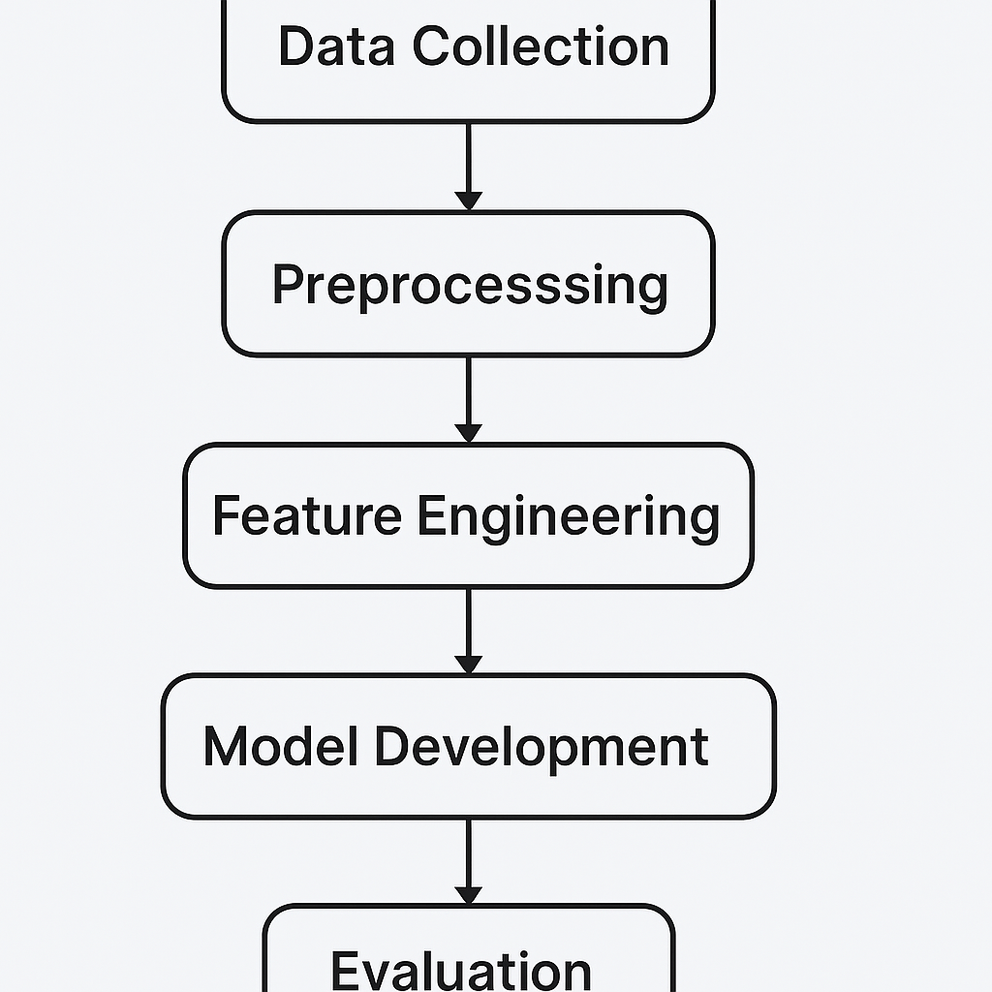
FLOW CHART-

Slide 10
Results and Outputs
Observed Pricing Trends-:
Peak Hour Pricing: Fares increased by 30-50% during morning and evening rush hours.
Event-Based Surge: Significant fare hikes (up to 2-3x) during local festivals, concerts, or public events.
Weather Impact: Rainy days and extreme weather conditions led to noticeable price surges, even for short distances.
Driver Insights-:
Earnings Increase: Drivers observed higher earnings during surge periods but felt pressure to work longer hours to maximize income.
Availability Challenge: Some drivers avoided working in extreme conditions (e.g., heavy rains) despite higher demand, limiting supply.

Slide 11
Results and Outputs
Model Accuracy: Ensemble achieved 8.3% MAPE — 29% better than the best individual model (XGBoost).
Temporal Analysis:
Peak hour and off-peak accuracy maintained below 9% error.
Weekends slightly more variable but consistent (<10% MAPE).
Spatial Analysis:
Central city areas (commercial zones) had highest forecast accuracy (~7.2% MAPE).
Periphery zones had slightly higher errors (~10.5% MAPE).

Slide 12
Conclusion
Developed a robust ensemble model that significantly improves ride request predictions.
Integrated multiple factors — time, weather, spatial data — for better decision making.
Achieved reliable accuracy across various cities and under different conditions (normal days, special events).
Supports operational goals like better fleet allocation, lower wait times, and strategic planning.

Slide 13
Future Scope
Add real-time updating models to react instantly to disruptions or live events.
Integrate more data sources like social media signals and real-time traffic feeds.
Explore graph neural networks for deeper spatial relationship modeling between zones.
Apply model across different services (e.g., four-wheeler Ola rides, food delivery platforms).

Slide 14
References
[1] S. Mukherjee et al., "Growth Patterns and Market Analysis of Ride-Sharing Services," Journal of Transportation Economics and Policy, 2020.
[2] P. Verma, S. Chatterjee, "Time Series Analysis for Taxi Demand Prediction," International Journal of Urban Transportation Systems, 2019.
[3] B. Kumar et al., "Hybrid Forecasting Models for Ride-Hailing Services," Transportation Research Part C, 2020.
[4] Y. Zhou, R. Li, "Deep Learning Approaches for Ride Demand Prediction," Journal of Intelligent Transportation Systems, 2021.
[5] Sharma and Gupta, "Spatio-temporal Modeling for Ride-sharing Demand," Urban Analytics and City Science, 2022.
[6] Patel et al., "Demand Characteristic Analysis of Two-wheeler Ride-sharing Services," Journal of Transportation Management, 2022. (Add 2–3 more if needed.)

